Slide 1
Metrology with ISN confocal microscope
Make sure the stage controller is turned on
Place sample under lens, somewhat centered.

Slide 2
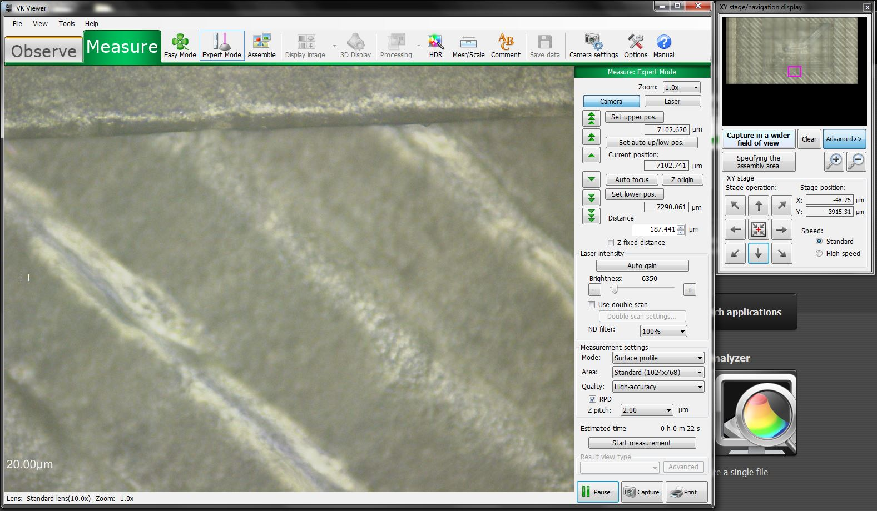
Metrology with ISN confocal microscope
Using the grey navigation arrows, move over the sample to find a long horizontal feature (either an edge of the sample or one of the lower steps of the pyramid). Place that feature next to the top or bottom edge of the image on the screen.
Navigation arrows
Long horizontal feature
(edge of bottom step of pyramid)

Slide 3
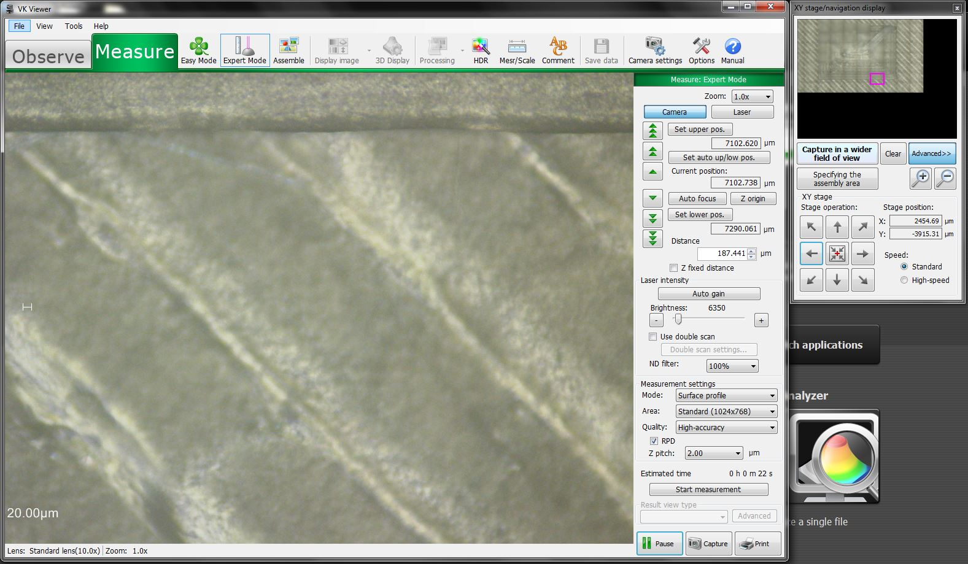
Metrology with ISN confocal microscope
Turn the microscope stage manually until the horizontal feature appears parallel to the image frame. Using the horizontal navigation arrows, swipe along the whole feature to make sure the alignment is correct.
Before alignment
After alignment

Slide 4
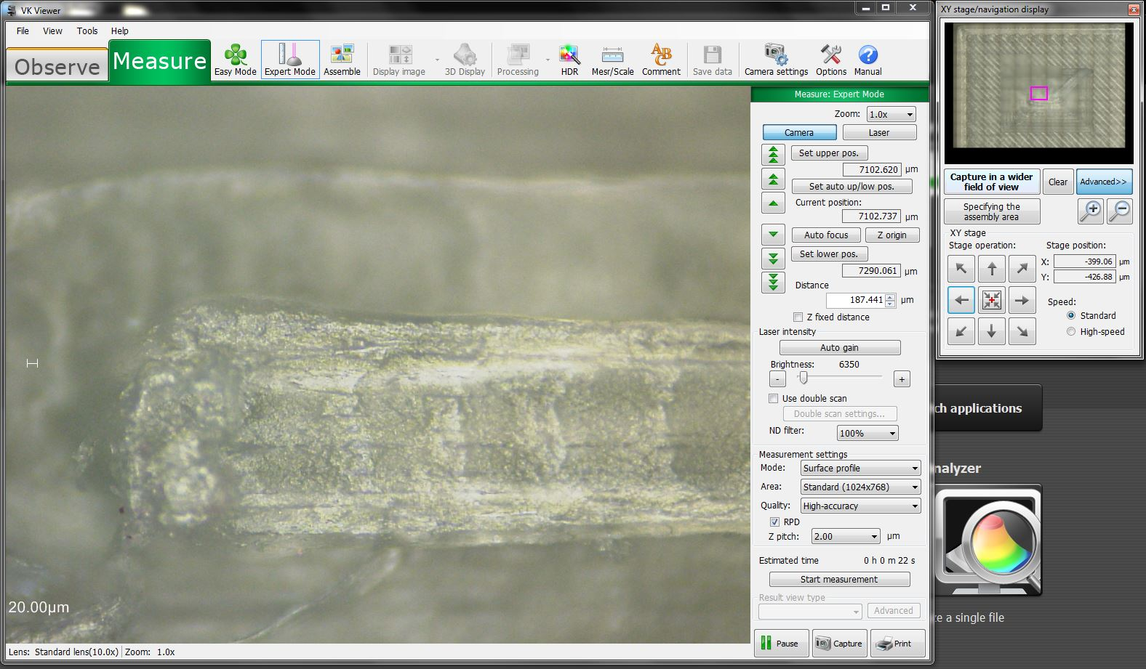
Metrology with ISN confocal microscope
Using the navigation arrows, find the highest step of the pyramid and center the view on it.

Slide 5
Metrology with ISN confocal microscope
Click on “Create image”.

Slide 6
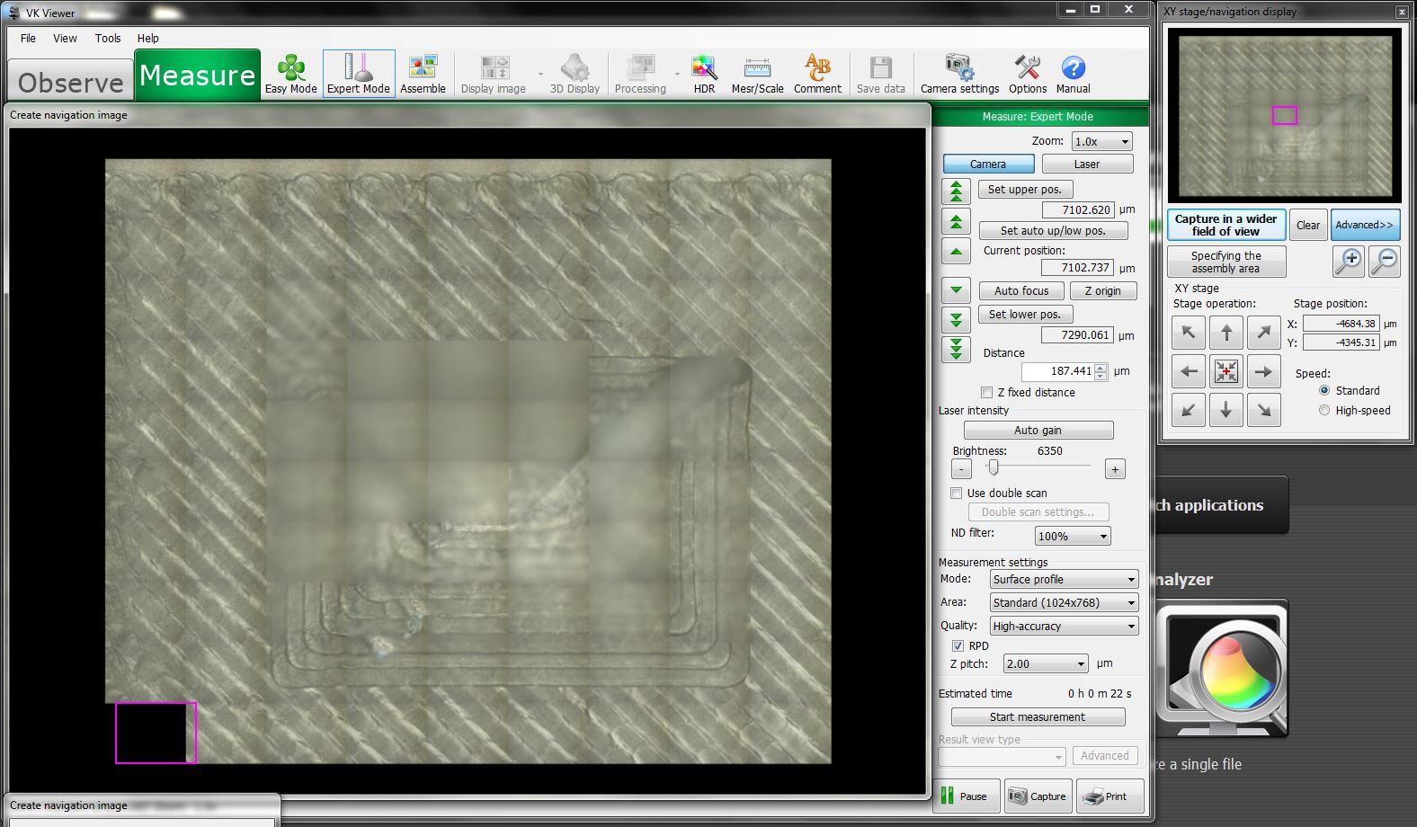
Metrology with ISN confocal microscope
Click on “Capture in wider field of view”. While the navigation image is generated, you can use the wheels and the green arrows to change focus. The more area of the sample you manage to get in focus, the easier it will be to navigate it and define the assembly area.

Slide 7
Metrology with ISN confocal microscope
Click on “Capture in wider field of view” until all the steps of the pyramid and a reasonable margin around them are captured.

Slide 8
Metrology with ISN confocal microscope
Click on “Specify the assembly area”.

Slide 9
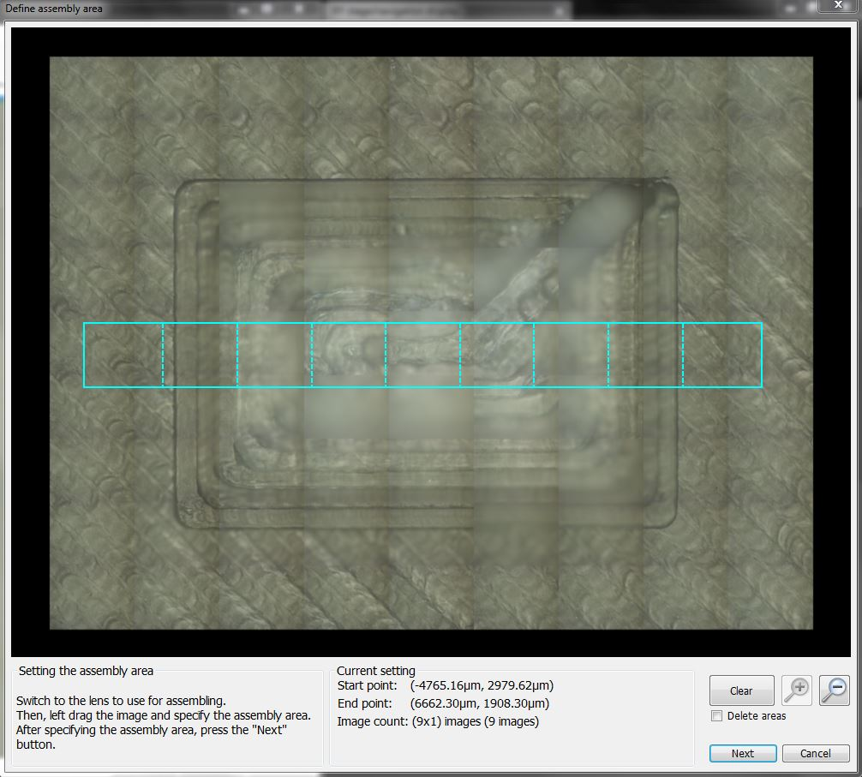
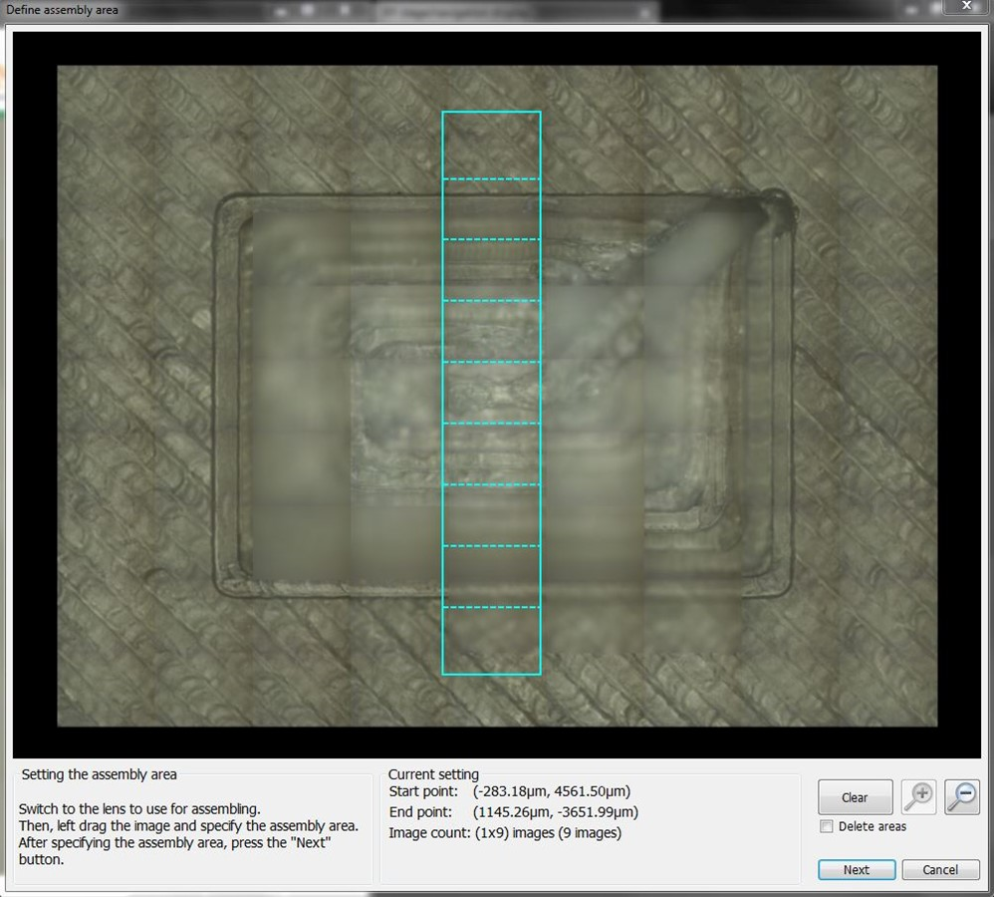
Metrology with ISN confocal microscope
Draw an assembly area that spans over the full pyramid from side to side, in one stripe, passing over the top step and leaving some margin on each side (needed to average the support layer for reference). Click on “Next”.
X
Y

Slide 10
Metrology with ISN confocal microscope
If “Auto setting” is good enough, continue to the next step. If not (or if not sure), see section on Manual height range setting.
“Auto setting” usually works for samples in which the height difference between the highest and the lowest features to be measured is around 1 mm or less.

Slide 11
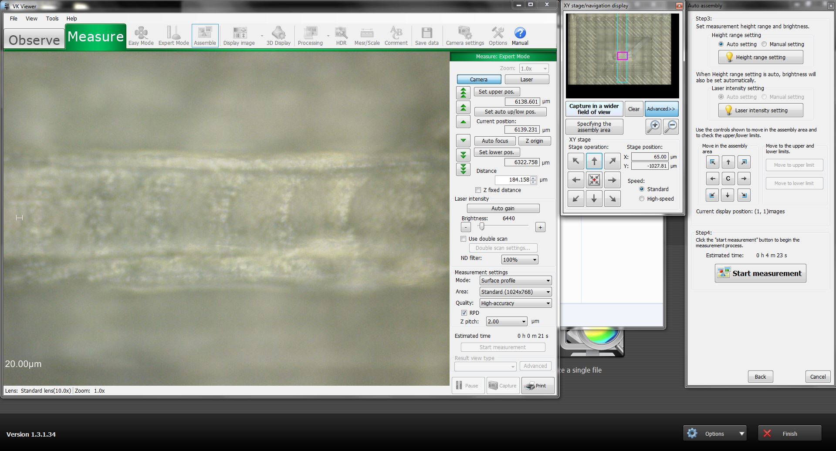
Metrology with ISN confocal microscope
Using the navigation arrows, move the lens to the center of the pyramid. With the green arrows (not the wheels), get the top in focus, and then go slightly past it.
Focus is slightly over the highest step

Slide 12
Metrology with ISN confocal microscope
Click “Start measurement”. When prompted, choose the folder to save the files in, and file name.

Slide 13
Metrology with ISN confocal microscope
Wait…
Keep an eye on the images as they are taken, especially when capturing the top of the pyramid. If, after finishing, an area of the image appears completely black for no reason, the measurement has most likely failed in that section. The software might notice and suggest to repeat that capture in recovery mode. If the issue persists, try again.

Slide 14
Metrology with ISN confocal microscope
Once the measurements are done, in the screen that pops up, click on “File”, “Execute assembly”, “Yes”, (“OK”), “Confirm assembly”.
Note: saving either “Laser image” or “Laser+Optical” does not seem to have any effect on the data resulting from the “Profile” tool).

Slide 15
Metrology with ISN confocal microscope
Back to the observation/measuring window, click on “Finish”

Slide 16
Metrology with ISN confocal microscope
Repeat from here if you need to measure the second dimension.

Slide 17
Metrology with ISN confocal microscope
Take sample out and repeat from the beginning if measuring a new sample.

Slide 18
Metrology with ISN confocal microscope
“Auto setting” usually works for samples in which the height difference between the highest and the lowest features to be measured is around 1 mm or less. If the sample ranges over a larger height difference, the height limits manually need to be set manually.
How to find out if “Auto setting” can handle the sample (if in doubt):
Find the highest feature and focus on it using the green arrows.
Move to the lowest feature and focus on it using the green arrows. The software might prompt you to reset Z. Allow it and focus.
Move back to the highest feature and focus on it using the green arrows.
Use “Capture in wider field of view” and specify an assembly area that includes the highest and the lowest features.
Click on “Start measurement” and pay attention to the images being captured, especially around the lowest feature.
If all the details are visible, “Auto setting” can resolve the sample.
If, at any point, the images seem to come out blurry, or even blank, the “Auto setting” is not managing to find the proper boundaries for the measurement. Manual setting is required.

Slide 19
Metrology with ISN confocal microscope
Manual height range setting:
Press “Cancel” (if in the middle of a measurement), and then specify the assembly area that you want to measure.
Select “Manual setting” in “Height range setting”.
With the grey arrows, move the lens so it shows the area that includes the lowest feature.
Use the green arrows to get the lowest feature in focus. If you get the message “Reached the upper/lower limit”, select “Yes” and try again.
Once the lowest feature is in focus, click on “Set lower pos.”
Use the grey arrows to go back to the highest feature and get it in focus with the green arrows. You can hold the green arrow down to swipe focus faster.
Once the highest feature is in focus, click on “Set upper pos.”
Click on “Start measurement”. Make sure that “Manual setting” is selected before clicking on “Start measurement”, especially if new measurements are taken with the same settings.
Back here (it might take a while).

